Slide 1
CS 61C: Great Ideas in Computer Architecture (Machine Structures) Operating Systems, Interrupts, Virtual Memory
Instructors:
Krste Asanovic & Vladimir Stojanovic
Guest Lecturer: Martin Maas
http://inst.eecs.berkeley.edu/~cs61c/

Slide 2
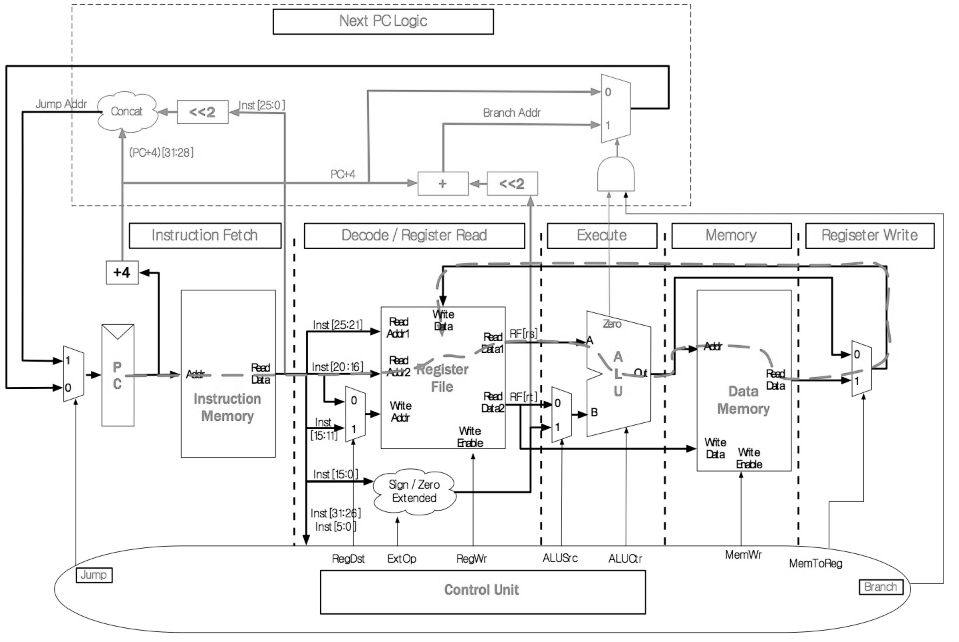
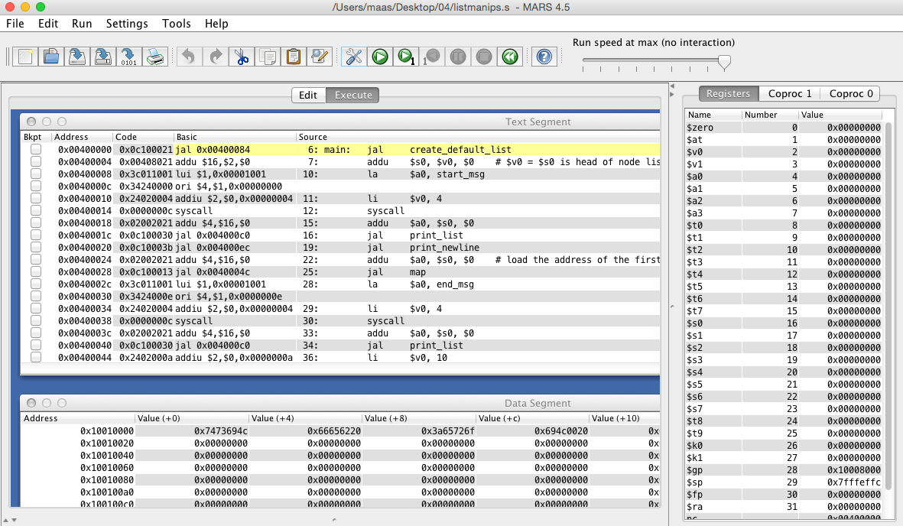
CS61C so far…
C Programs
MIPS Assembly
#include <stdlib.h>
int fib(int n) {
return fib(n-1) + fib(n-2);
}
Project 2
.foo
lw $t0, 4($r0)
addi $t1, $t0, 3
beq $t1, $t2, foo nop
CPU
Project 1
Labs
Caches
Memory

Slide 3
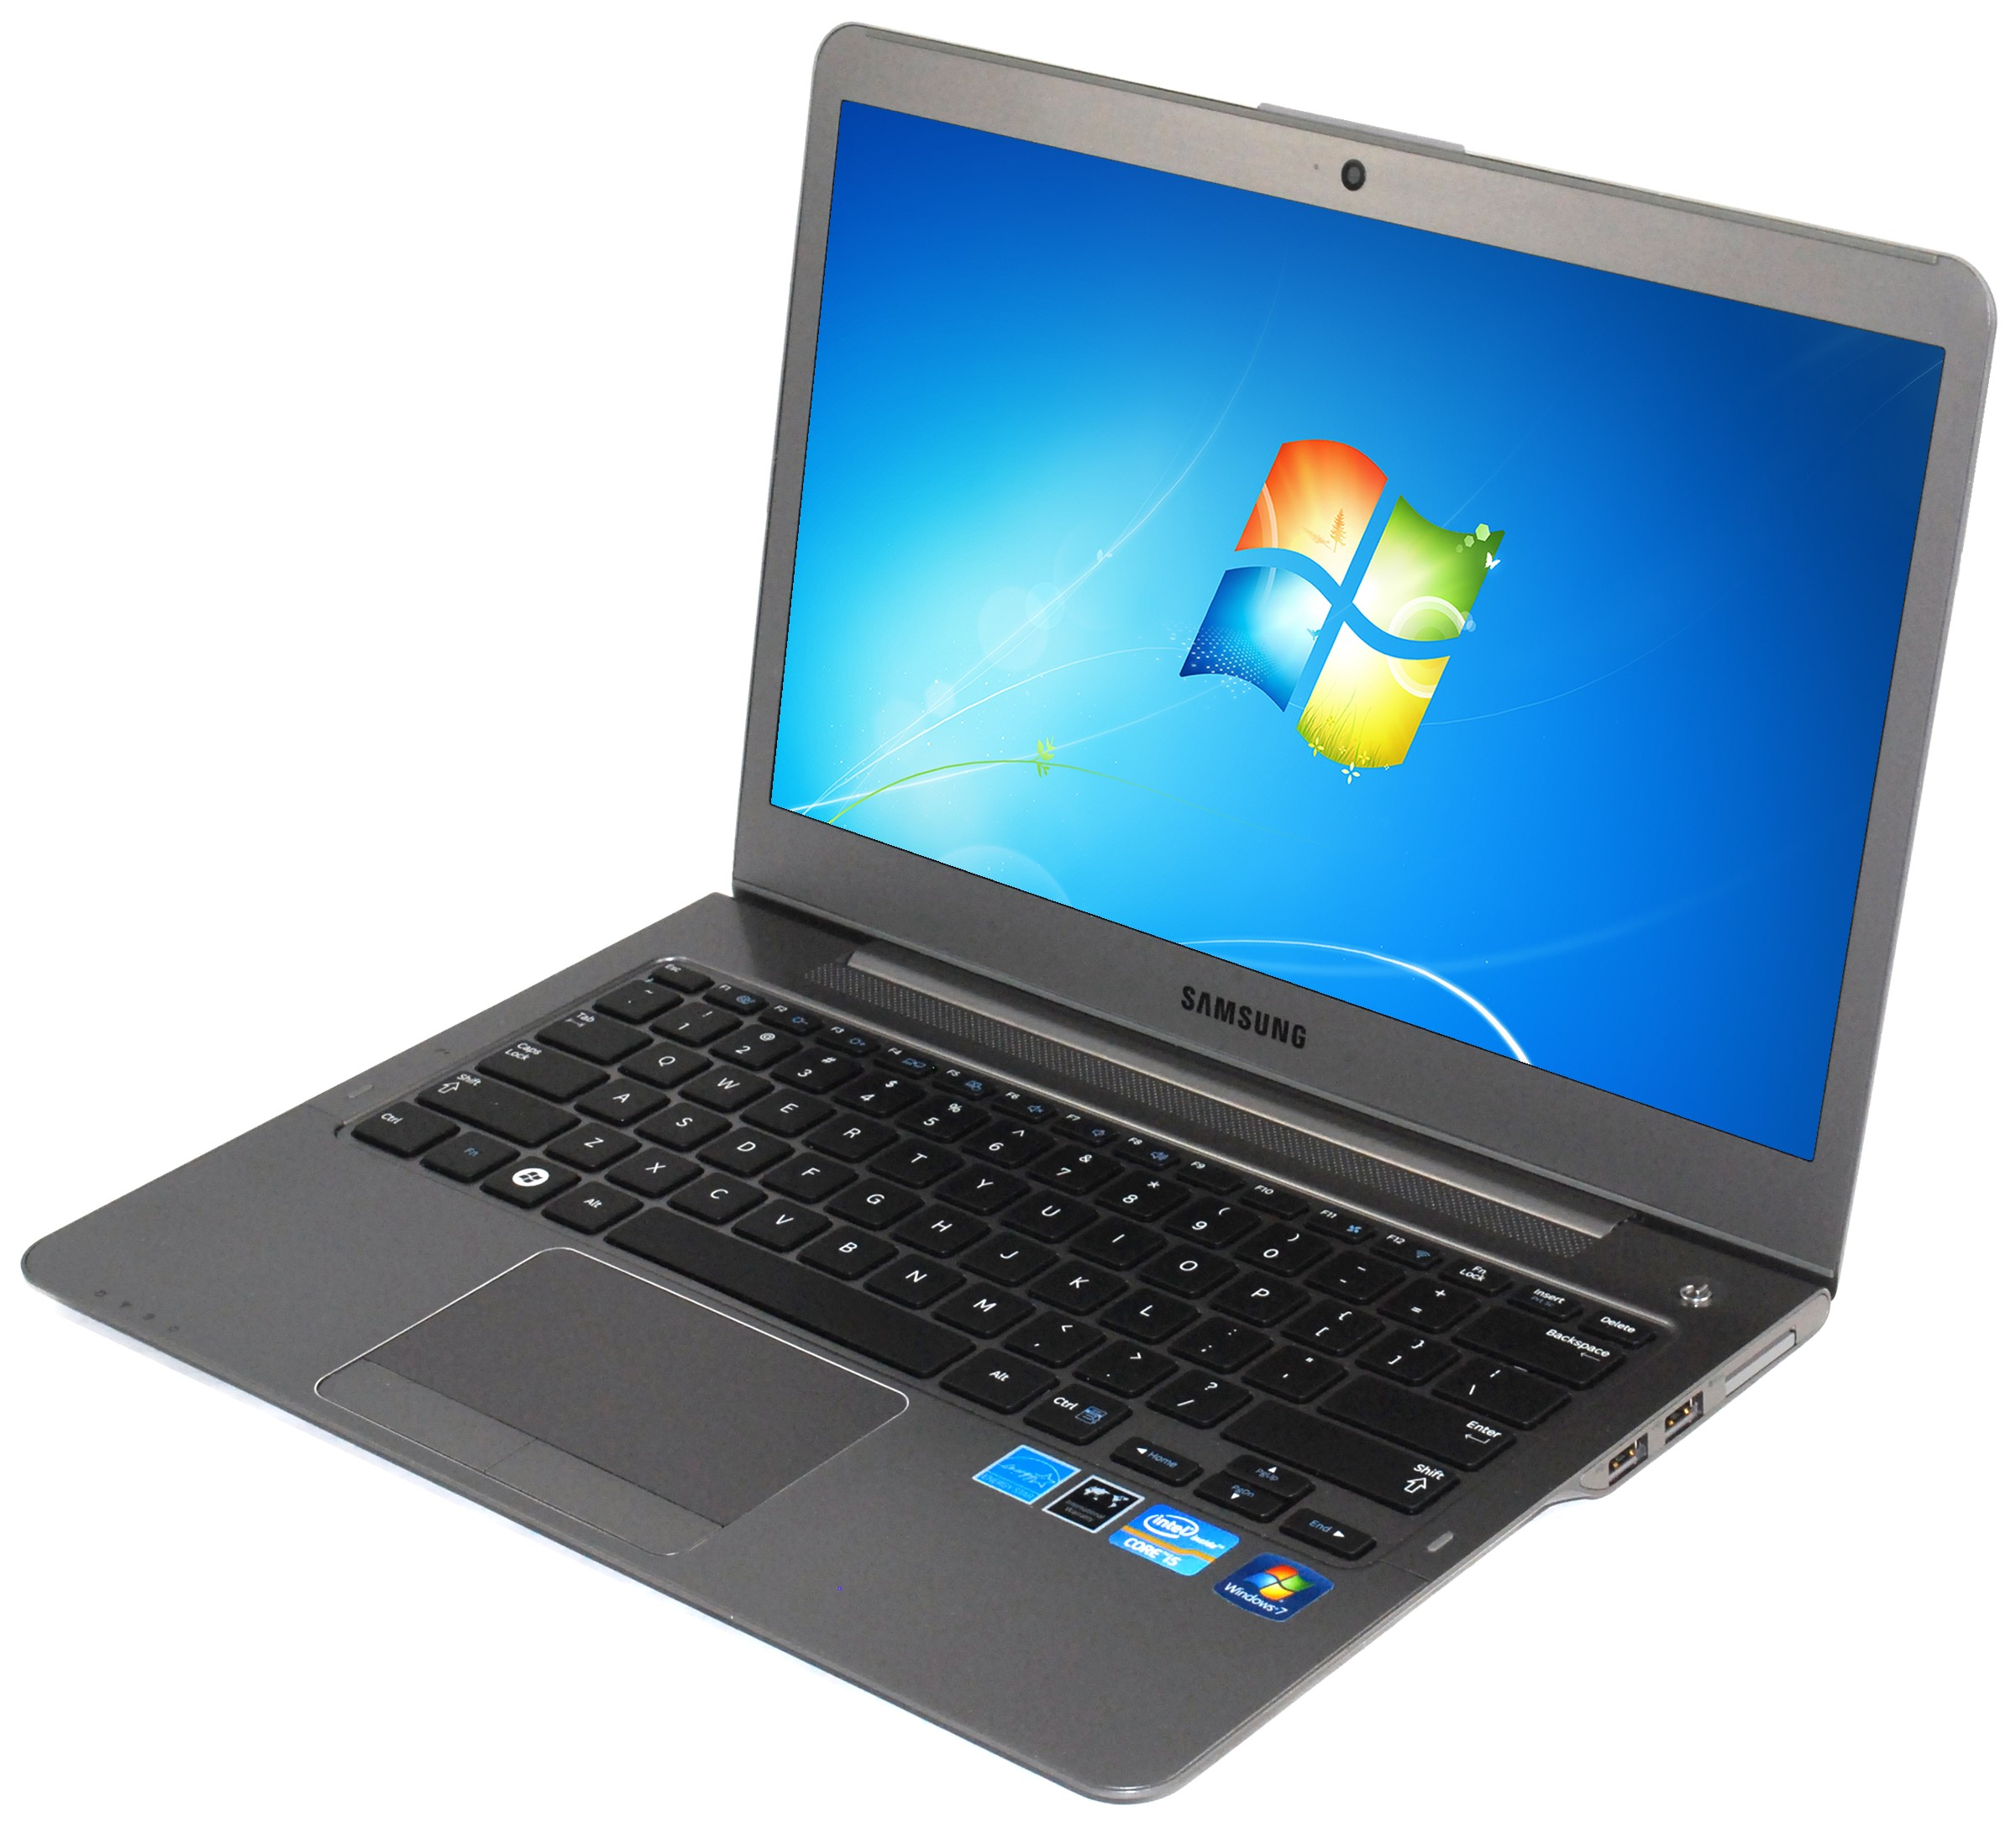
So how is this any different?
Screen
Keyboard
Storage

Slide 4
Adding I/O
C Programs
MIPS Assembly
#include <stdlib.h>
int fib(int n) {
return fib(n-1) + fib(n-2);
}
Project 2
.foo
lw $t0, 4($r0)
addi $t1, $t0, 3
beq $t1, $t2, foo nop
CPU
Project 1
Screen
Keyboard
Storage
Caches
I/O (Input/Output)
Memory

Slide 5
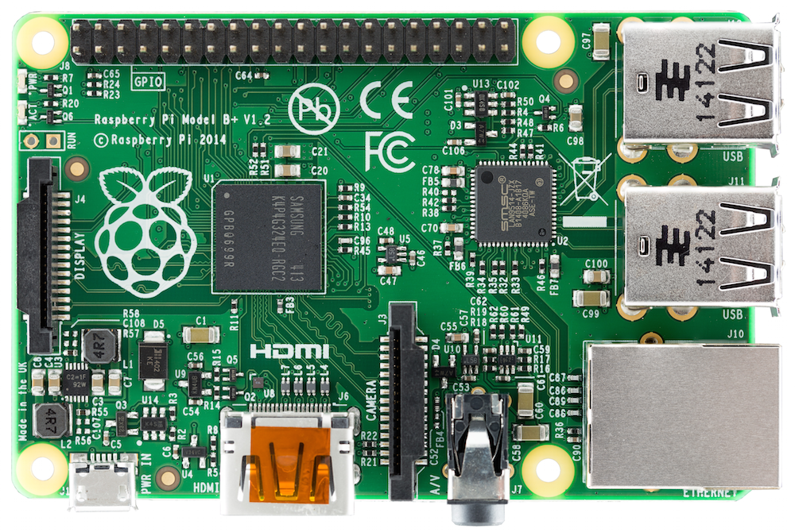
Raspberry Pi ($40 on Amazon)
Serial I/O
(USB)
Storage I/O
(Micro SD Card)
CPU+$s, etc.
Memory
Network I/O
(Ethernet)
Screen I/O
(HDMI)
Notes:
I/o stuff

Slide 6
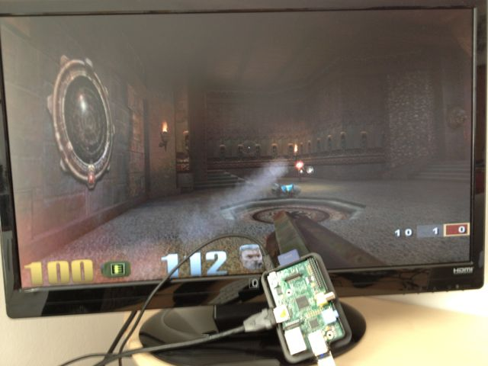
It’s a real computer!

Slide 7
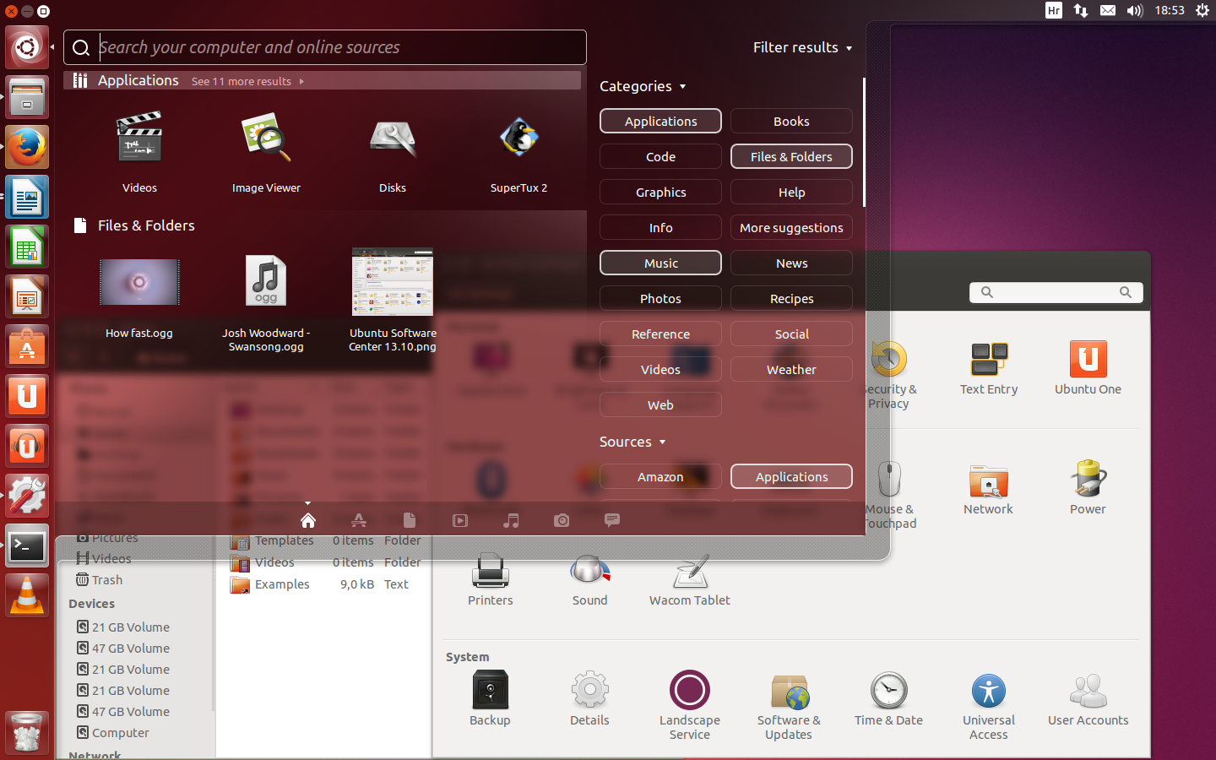
But wait…
That’s not the same! When we run MARS, it only executes one program and then stops.
When I switch on my computer, I get this:
Yes, but that’s just software! The Operating System (OS)

Slide 8
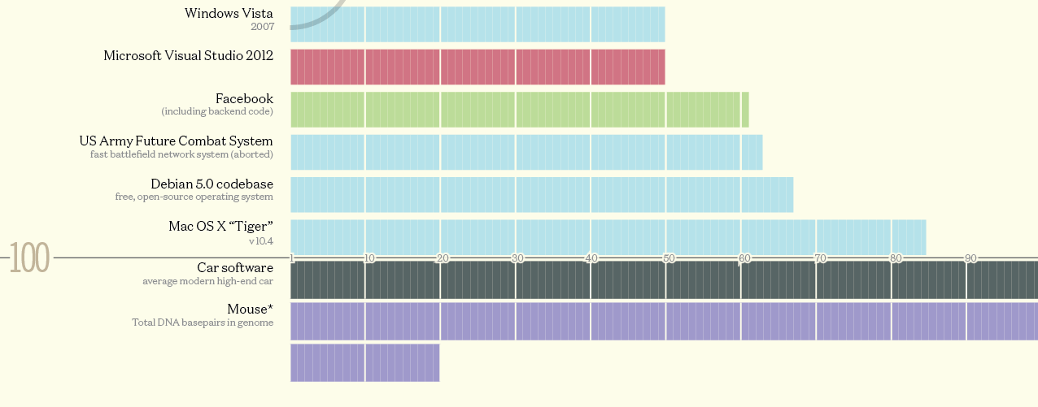
Well, “just software”
The biggest piece of software on your machine?
How many lines of code? These are guesstimates:
Codebases (in millions of lines of code). CC BY-NC 3.0 — David McCandless © 2013 http://www.informationisbeautiful.net/visualizations/million-lines-of-code/

Slide 9
What does the OS do?
One of the first things that runs when your computer starts (right after firmware/bootloader)
Loads, runs and manages programs:
Multiple programs at the same time (time-sharing)
Isolate programs from each other (isolation)
Multiplex resources between applications (e.g., devices)
Services: File System, Network stack, etc.
Finds and controls all the devices in the machine in a general way (using “device drivers”)
Notes:
Runs multiple programs at the same time and also isolates it
Allocate resources between applications that may use the same resource at the same time

Slide 10
Agenda
Devices and I/O
OS Boot Sequence and Operation
Multiprogramming/time-sharing
Introduction to Virtual Memory

Slide 11
Agenda
Devices and I/O
OS Boot Sequence and Operation
Multiprogramming/time-sharing
Introduction to Virtual Memory

Slide 12

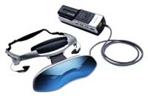
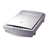


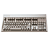
How to interact with devices?
Assume a program running on a CPU. How does it interact with the outside world?
Need I/O interface for Keyboards, Network, Mouse, Screen, etc.
Connect to many types of devices
Control these devices, respond to them, and transfer data
Present them to user programs so they are useful
Operating System
Proc
Mem
PCI Bus
SCSI Bus
cmd reg.
data reg.
Notes:
Access to external devices

Slide 13
Instruction Set Architecture for I/O
What must the processor do for I/O?
Input: reads a sequence of bytes
Output: writes a sequence of bytes
Some processors have special input and output instructions
Alternative model (used by MIPS):
Use loads for input, stores for output (in small pieces)
Called Memory Mapped Input/Output
A portion of the address space dedicated to communication paths to Input or Output devices (no memory there)
Notes:
Memory mapped i/o – uses memory that you use for normal instructions and uses it for I/O
Certain memroy spaces are just for the device

Slide 14
Memory Mapped I/O
Certain addresses are not regular memory
Instead, they correspond to registers in I/O devices
address
0xFFFFFFFF
0xFFFF0000
cntrl reg.
data reg.
0

Slide 15
Processor-I/O Speed Mismatch
1GHz microprocessor can execute 1B load or store instructions per second, or 4,000,000 KB/s data rate
I/O data rates range from 0.01 KB/s to 1,250,000 KB/s
Input: device may not be ready to send data as fast as the processor loads it
Also, might be waiting for human to act
Output: device not be ready to accept data as fast as processor stores it
What to do?
Notes:
Different I/O speeds mean that

Slide 16
Processor Checks Status before Acting
Path to a device generally has 2 registers:
Control Register, says it’s OK to read/write (I/O ready) [think of a flagman on a road]
Data Register, contains data
Processor reads from Control Register in loop, waiting for device to set Ready bit in Control reg (0  1) to say it’s OK
Processor then loads from (input) or writes to (output) data register
Load from or Store into Data Register resets Ready bit (1  0) of Control Register
This is called “Polling”
Notes:
Have specific registers that tell you whether the data is available,

Slide 17
I/O Example (polling)
Input: Read from keyboard into $v0
lui $t0, 0xffff #ffff0000 Waitloop: lw $t1, 0($t0) #control andi $t1,$t1,0x1 beq $t1,$zero, Waitloop lw $v0, 4($t0) #data
Output: Write to display from $a0
lui $t0, 0xffff #ffff0000 Waitloop: lw $t1, 8($t0) #control andi $t1,$t1,0x1 beq $t1,$zero, Waitloop sw $a0, 12($t0) #data
“Ready” bit is from processor’s point of view!

Slide 18
Cost of Polling?
Assume for a processor with a 1GHz clock it takes 400 clock cycles for a polling operation (call polling routine, accessing the device, and returning). Determine % of processor time for polling
Mouse: polled 30 times/sec so as not to miss user movement
Floppy disk (Remember those?): transferred data in 2-Byte units and had a data rate of 50 KB/second. No data transfer can be missed.
Hard disk: transfers data in 16-Byte chunks and can transfer at 16 MB/second. Again, no transfer can be missed. (we’ll come up with a better way to do this)

Slide 19
% Processor time to poll
Mouse Polling [clocks/sec]
= 30 [polls/s] * 400 [clocks/poll] = 12K [clocks/s]
% Processor for polling:
12*10³ [clocks/s] / 1*10⁹ [clocks/s] = 0.0012%
⇒ Polling mouse little impact on processor
Notes:
was p 677 in book (not current edition)

Slide 20
Clicker Time
Hard disk: transfers data in 16-Byte chunks and can transfer at 16 MB/second. No transfer can be missed. What percentage of processor time is spent in polling?
A: 2%
B: 4%
C: 20%
D: 40%
E: 80%

Slide 21
% Processor time to poll hard disk
Frequency of Polling Disk
= 16 [MB/s] / 16 [B/poll] = 1M [polls/s]
Disk Polling, Clocks/sec = 1M [polls/s] * 400 [clocks/poll] = 400M [clocks/s]
% Processor for polling:
400*10⁶ [clocks/s] / 1*10⁹ [clocks/s] = 40%
⇒ Unacceptable
(Polling is only part of the problem – main problem is that accessing in small chunks is inefficient)

Slide 22
What is the alternative to polling?
Wasteful to have processor spend most of its time “spin-waiting” for I/O to be ready
Would like an unplanned procedure call that would be invoked only when I/O device is ready
Solution: use exception mechanism to help I/O. Interrupt program when I/O ready, return when done with data transfer
Allow to register interrupt handlers: functions that are called when an interrupt is triggered
Notes:
Modify cpu so that execution can be interrupted by devices and a table that will have the addresses to jump to when i/o is available

Slide 23
Interrupt-driven I/O
Handler Execution
Incoming interrupt suspends instruction stream
Looks up the vector (function address) of a handler in an interrupt vector table stored within the CPU
Perform a jal to the handler (needs to store any state)
Handler run on current stack and returns on finish (thread doesn’t notice that a handler was run)
Stack Frame
Stack Frame
handler: lui $t0, 0xffff
lw $t1, 0($t0)
andi $t1,$t1,0x1
lw $v0, 4($t0)
sw $t1, 8($t0)
ret
Stack Frame
Label: sll $t1,$s3,2 addu $t1,$t1,$s5 lw $t1,0($t1)
add $s1,$s1,$t1 addu $s3,$s3,$s4 bne $s3,$s2,Label
CPU Interrupt Table
SPI0 | handler
… | …
Interrupt(SPI0)

Slide 24

Administrivia
DEADLINE!!!
Project 3 is due on Sunday, 19 April, 23:59pm
Try to get it to run at 3 KCat/s
Make sure it passes all tests!
You can make it much faster than that – take part in the competition!!!
Glory (and a small amount of extra credit) awaits for the most successful teams!

Slide 25
Agenda
Devices and I/O
OS Boot Sequence and Operation
Multiprogramming/time-sharing
Introduction to Virtual Memory

Slide 26
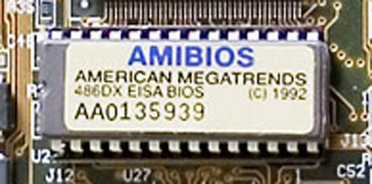
What happens at boot?
When the computer switches on, it does the same as MARS: the CPU executes instructions from some start address (stored in Flash ROM)
CPU
Memory mapped
0x2000:
addi $t0, $zero, 0x1000
lw $t0, 4($r0)
…
(Code to copy firmware into regular memory and jump into it)
PC = 0x2000 (some default value)
Address Space
Notes:
Sets pc to some default value and starts executing Rom is fixed on your hardware
Load rom data into memory and then runs

Slide 27
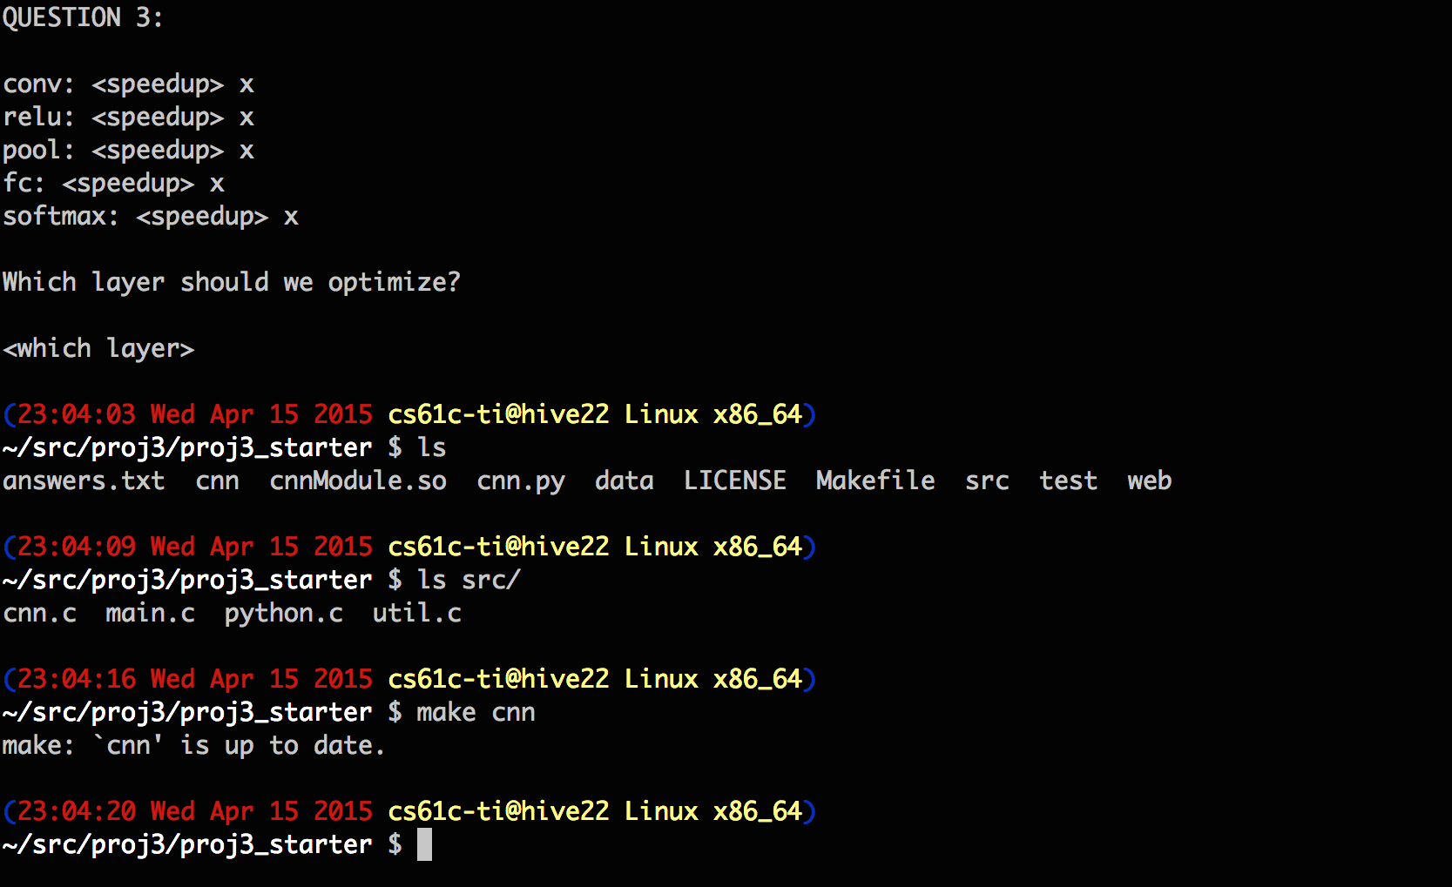
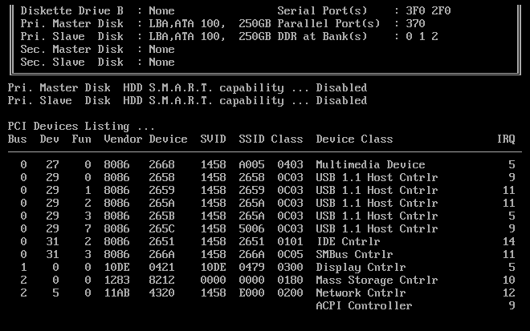
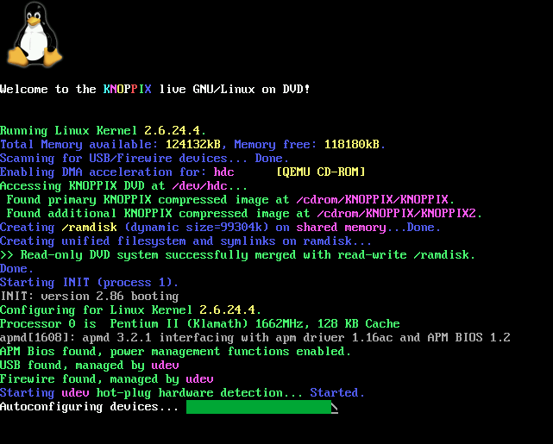
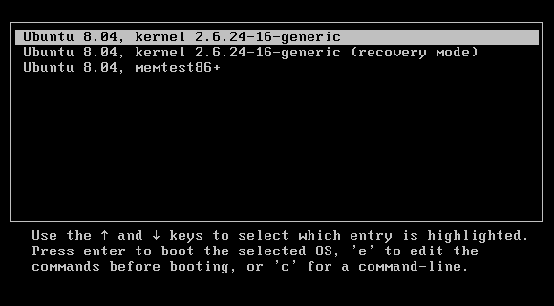
What happens at boot?
When the computer switches on, it does the same as MARS: the CPU executes instructions from some start address (stored in Flash ROM)
1. BIOS: Find a storage device and load first sector (block of data)
4. Init: Launch an application that waits for input in loop (e.g., Terminal/Desktop/...
2. Bootloader (stored on, e.g., disk): Load the OS kernel from disk into a location in memory and jump into it.
3. OS Boot: Initialize services, drivers, etc.
Notes:
Reads from rom and executes bios
Can access hdd and reads first block which is the bootloader
Bootloader accesses harddrive, loads into memory and runs it
Can run execution files

Slide 28
Launching Applications
Applications are called “processes” in most OSs.
Created by another process calling into an OS routine (using a “syscall”, more details later).
Depends on OS, but Linux uses fork (see OpenMP threads) to create a new process, and execve to load application.
Loads executable file from disk (using the file system service) and puts instructions & data into memory (.text, .data sections), prepare stack and heap.
Set argc and argv, jump into the main function.

Slide 29
Supervisor Mode
If something goes wrong in an application, it can crash the entire machine. What about malware, etc.?
The OS may need to enforce resource constraints to applications (e.g., access to devices).
To protect the OS from the application, CPUs have a supervisor mode bit (also need isolation, more later).
You can only access a subset of instructions and (physical) memory when not in supervisor mode (user mode).
You can change out of supervisor mode using a special instruction, but not into it (unless there is an interrupt).

Slide 30
Syscalls
How to switch back to OS? OS sets timer interrupt, when interrupts trigger, drop into supervisor mode.
What if we want to call into an OS routine? (e.g., to read a file, launch a new process, send data, etc.)
Need to perform a syscall: set up function arguments in registers, and then raise software interrupt
OS will perform the operation and return to user mode
This way, the OS can mediate access to all resources, including devices, the CPU itself, etc.
Notes:
Software interrupt leaves the current application and implements whatever the syscall is before returning to the application

Slide 31
Agenda
Devices and I/O
OS Boot Sequence and Operation
Multiprogramming/time-sharing
Introduction to Virtual Memory

Slide 32
Multiprogramming
The OS runs multiple applications at the same time.
But not really (unless you have a core per process)
Switches between processes very quickly. This is called a “context switch”.
When jumping into process, set timer interrupt.
When it expires, store PC, registers, etc. (process state).
Pick a different process to run and load its state.
Set timer, change to user mode, jump to the new PC.
Deciding what process to run is called scheduling.
Notes:
When switching between applications a snapshot of the data is taken and after running the other application and returns to the current one, it reloads that snapshot

Slide 33
Protection, Translation, Paging
Supervisor mode does not fully isolate applications from each other or from the OS.
Application could overwrite another application’s memory.
Remember your Project 1 linker: application assumes that code is in certain location. How to prevent overlaps?
May want to address more memory than we actually have (e.g., for sparse data structures).
Solution: Virtual Memory. Gives each process the illusion of a full memory address space that it has completely for itself.
Notes:
Virtual memory isolates applications from one another so that one does not influence the other

Slide 34
Agenda
Devices and I/O
OS Boot Sequence and Operation
Multiprogramming/time-sharing
Introduction to Virtual Memory

Slide 35
Modern Virtual Memory Systems Illusion of a large, private, uniform store
Protection
several users, each with their private address space and one or more shared address spaces
page table ≡ name space
Demand Paging
Provides the ability to run programs larger than the primary memory
Hides differences in machine configurations
The price is address translation on
each memory reference
OS
user_{i}
Swapping
Store
Primary
Memory
VA
mapping
PA
TLB
Notes:
Portability on machines with different memory configurations.

Slide 36
“Bare” 5-Stage Pipeline
PC
Physical Address
D
E
M
Physical Address
W
Inst. Cache
Decode
Data Cache
+
Memory Controller
Physical Address
Physical Address
Physical Address
Main Memory (DRAM)
In a bare machine, the only kind of address is a physical address

Slide 37
Dynamic Address Translation
Motivation
In early machines, I/O operations were slow and each word transferred involved the CPU
Higher throughput if CPU and I/O of 2 or more programs were overlapped.
Location-independent programs
Programming and storage management ease
⇒ need for a base register
Protection
Independent programs should not affect
each other inadvertently
⇒ need for a bound register
Multiprogramming drives requirement for resident supervisor (OS) software to manage context switches between multiple programs
prog1
Physical Memory
prog2
OS
Notes:
Dynamic address gets translated to physical address

Slide 38
Simple Base and Bound Translation
Segment Length
Bound
Register
≤
Bounds
Violation?
Physical
Address
current
segment
Logical
Address
Physical Memory
Load X
+
Base
Register
Base Physical Address
Program
Address Space
Base and bounds registers are visible/accessible only when processor is running in supervisor mode

Slide 39
Separate Areas for Program and Data
(Scheme used on all Cray vector supercomputers prior to X1, 2002)
Data Bound Register
≤
Bounds
Violation?
Logical Address
data
segment
Mem. Address Register
Load X
Data Base Register
+
Physical Address
Main Memory
Program
Address
Space
Program Bound Register
≤
Bounds
Violation?
Logical Address
program
segment
Program Counter
Program Base Register
+
Physical Address
What is an advantage of this separation?
Notes:
Permits sharing of program segments.

Slide 40
Base and Bound Machine
Prog. Bound Register
Data Bound Register
Bounds Violation?
Bounds Violation?
≤
≤
Logical Address
Logical Address
PC
D
Decode
E
M
W
Inst. Cache
Data Cache
+
+
+
Physical Address
Physical Address
Program Base Register
Data Base Register
Physical Address
Physical Address
Memory Controller
Physical Address
Main Memory (DRAM)
[ Can fold addition of base register into (register+immediate) address calculation using a carry-save adder (sums three numbers with only a few gate delays more than adding two numbers) ]

Slide 41
Memory Fragmentation
free
Users 4 & 5
arrive
Users 2 & 5
leave
OS
Space
OS
Space
OS
Space
user 1
16K
user 1
16K
user 1
16K
user 2
24K
user 2
24K
24K
user 4
16K
24K
user 4
16K
8K
8K
user 3
32K
user 3
32K
user 3
32K
24K
user 5
24K
24K
As users come and go, the storage is “fragmented”.
Therefore, at some stage programs have to be moved
around to compact the storage.
Notes:
Called Burping the memory.

Slide 42
Paged Memory Systems
Processor-generated address can be split into:
page number offset
A page table contains the physical address of the base of each page
1
0
0
0
1
1
Physical Memory
2
2
3
3
3
Address Space
of User-1
Page Table
of User-1
2
Page tables make it possible to store the pages of a program non-contiguously.
Notes:
Relaxes the contiguous allocation requirement.

Slide 43
Private Address Space per User
User 1
OS
pages
VA1
Page Table
User 2
VA1
Page Table
Physical Memory
User 3
VA1
Page Table
free
Each user has a page table
Page table contains an entry for each user page
Notes:
OS ensures that the page tables are disjoint.

Slide 44
Where Should Page Tables Reside?
Space required by the page tables (PT) is proportional to the address space, number of users, ...
⇒ Too large to keep in registers
Idea: Keep PTs in the main memory
Needs one reference to retrieve the page base address and another to access the data word
⇒ doubles the number of memory references!

Slide 45
Page Tables in Physical Memory
PT User 1
VA1
PT User 2
User 1 Virtual Address Space
Physical Memory
VA1
User 2 Virtual Address Space

Slide 46
In Conclusion
Once we have a basic machine, it’s mostly up to the OS to use it and define application interfaces.
Hardware helps by providing the right abstractions and features (e.g., Virtual Memory, I/O).
If you want to learn more about operating systems, you should take CS162!
What’s next in CS61C?
More details on I/O
More about Virtual Memory

